Slide 1
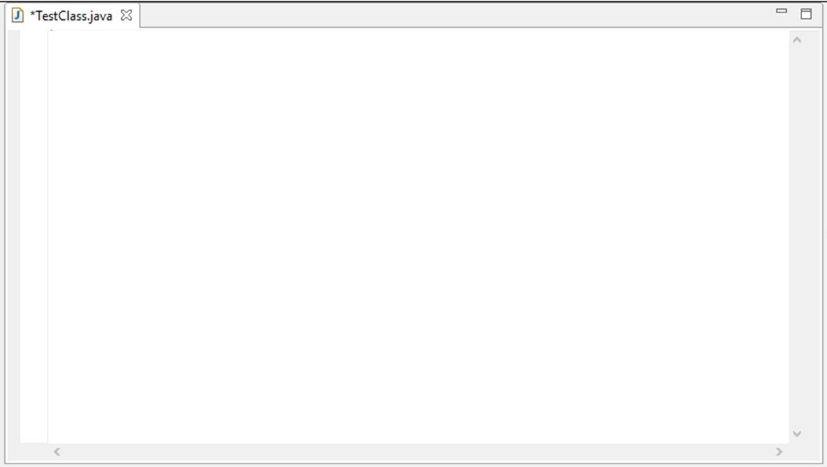
CSCI 5828 Foundations of Software Engineering
PRESENTATION - 1
ECLIPSE IDE
By –
Praveen Kumar Devaraj (prde1873)
Sharath Vontari (shvo9824)

Slide 2
ECLIPSE IDE
INTRODUCTION
What is IDE - Integrated Development Environment - Tool with features required for software development.
Eclipse is one such open source IDE used for developing softwares.
Can be used to develop software in C, C++,java, ABAP, COBOL, Python, Ruby etc.
Provides an open platform for application development tools run on a wide range of operating systems.
Can be used in any phase of development like Design, Development, Testing etc.
Provides features for seamless integration of software modules developed individually.
First release of the eclipse project was made in 2001 and has been growing since then.
Eclipse created by OTI and IBM teams responsible for IDE products
IBM VisualAge/Smalltalk (Smalltalk IDE)
IBM VisualAge/Java (Java IDE)
IBM VisualAge/Micro Edition (Java IDE)
Fig 1

Slide 3
What is Eclipse
What is Eclipse?
Eclipse is a universal platform for integrating development tools.
Eclipse Architecture
Plug-in - smallest unit of Eclipse function
Example – CDT, ObjectAid etc.
Plug-in development environment
PDE
JDT - provides the tool plug-ins that implement a Java IDE supporting the development of any Java application.
JDT
Java development tools
Eclipse Platform
Platform
Eclipse Platform - common base
JVM - an abstract computing machine that
enables a computer to run a Java program
Standard Java2 Virtual Machine
Java VM
3

Slide 4
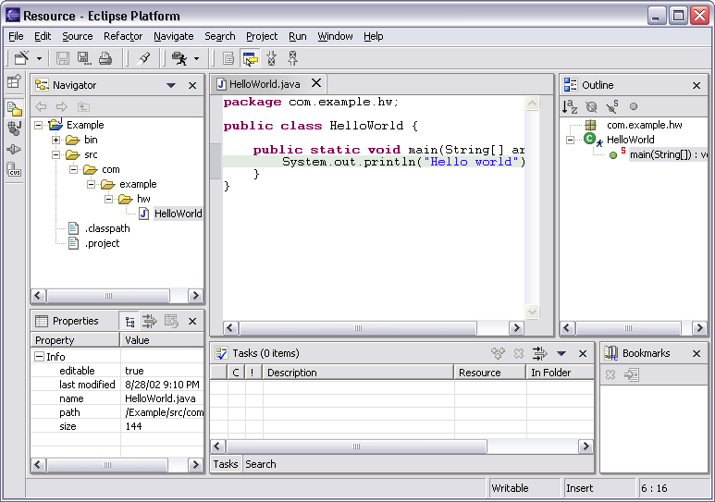
Eclipse User-Interface
User Interface of Eclipse can be changed according to the user preferences. This is a typical UI provided.
Menu bar
Tool bar
Text
editor
Perspective
and
Fast View
bar
Outline
view
Resource
Navigator
view
Bookmarks
view
Properties
view
Message
area
Editor
Status
area
Stacked
views
Tasks
view

Slide 5
Why Eclipse
Several reasons to use Eclipse -
Open Source – Free of Cost.
Supports most of the programming languages with appropriate plugins.
Single tool that can be used for design, development, testing etc.
User Friendly (Intuitive User Interface).
Can be integrated with several Version management (Ex: Perforce etc) and build softwares(Ex: ANT).
Available on most of the platforms.
Getting Eclipse
Download the latest version from here.
You may need to install Java SDK1.6 or JRE if you haven’t from here.
After installation the path variable is to be set to the bin folder of java installation.
Unpack the package and run eclipse.exe in windows or eclipse in Linux.

Slide 6
Plugins
Plug-in - smallest unit of Eclipse function
Typical arrangement in Plugin Architecture
plug-in A
plug-in B
extension point P
contributes
extension
Plug-in A
Declares extension point P
Declares interface I to go with P
Plug-in B
Implements interface I with its own class C
Contributes class C to extension point P
Plug-in A instantiates C and calls its I methods
implements
interface I
class C
creates, calls
Extension point - named entity for collecting “contributions” Example: extension point for workbench preference UI
Specified in the manifest.xml file of every plugin

Slide 7
The Eclipse runtime defines the plug-ins (org.eclipse.osgi and org.eclipse.core.runtime) on which all other plug-ins depend and is responsible for defining a structure for plug-ins and the implementation details of the same.
Plugin Installation
Plugins are mostly in java and can be installed either directly from the repository using the url or by downloading the package and importing the same.
To learn how to install the plugin directly from the repository check here
Eclipse Runtime
The runtime is also responsible for finding and executing the main Eclipse application and for maintaining a registry of plug-ins, their extensions, and extension points.
The runtime also provides utilities, such as logging, debug trace options, adapters, a preference store, and a concurrency infrastructure.

Slide 8
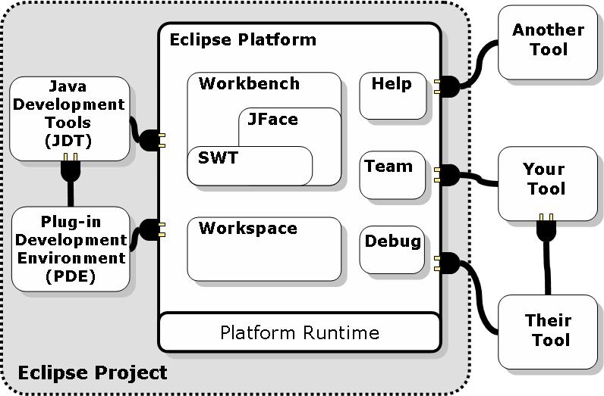
Eclipse Project Aims
Eclipse Platform Architecture Overview
SWT – Standard widget Toolkit - generic low-level graphics and widget set.
JFace -UI frameworks for common UI tasks
Tools here refer to plugins.

Slide 9
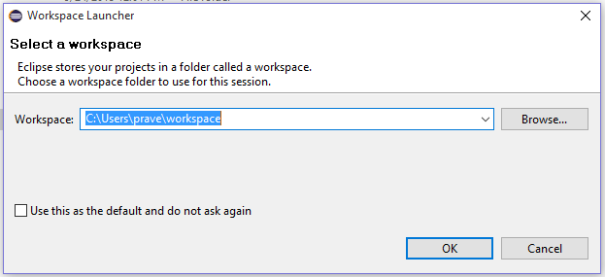
GETTING STARTED WITH ECLIPSE DEVELOPMENT
Create a Workspace for saving all the data handled and modified in eclipse.
On start up a pop up appears requesting the path for the workspace as shown below. Enter and Click OK.
Workspace is the directory used to store the source code and other data on which the user is working on in Eclipse.
This dialog appears only if the java path variable is configured correctly else it does not launch the IDE. To configure the path variable check here.
Eclipse can be used for design, development, testing etc. Lets consider them individually later.

Slide 10
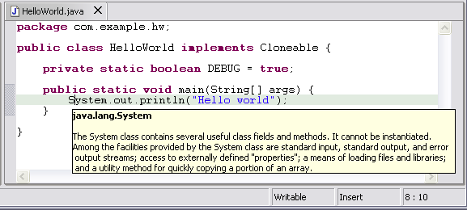
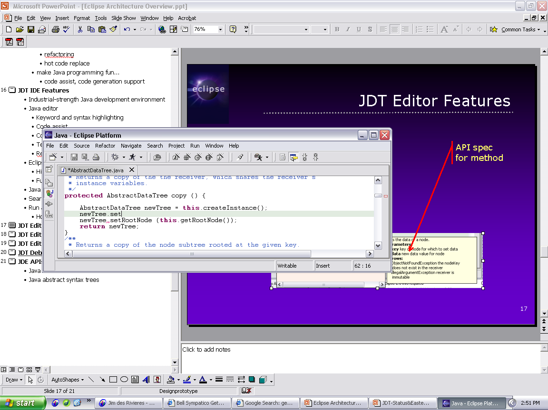
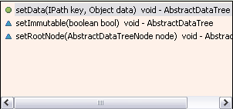
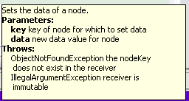
Features of Eclipse Java Editor
Hovering over identifier shows Javadoc spec (Fig1).
Method completion and suggestions to keywords (Fig2).
Spell Check
Java editor creates stub methods
Local method history
Code formatter
Source code for binary libraries
Built-in refactoring etc
Fig 1
List of plausible methods
Doc for method
Fig 2

Slide 11
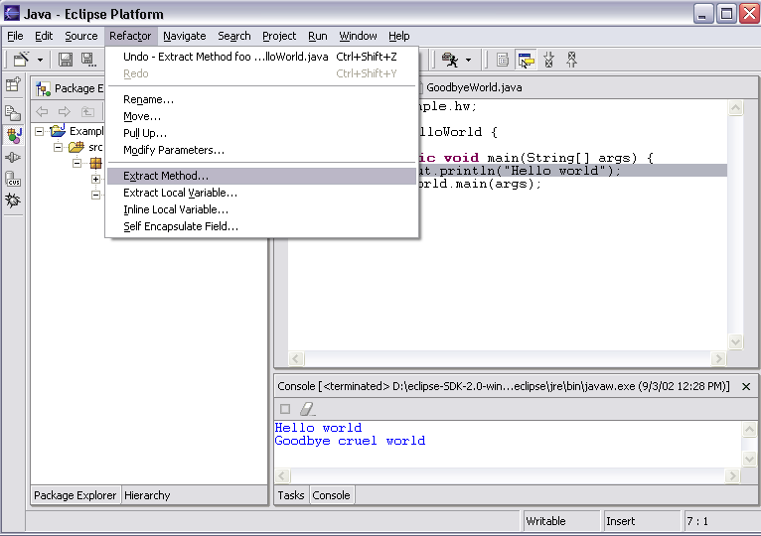
Code Refactoring in Eclipse
JDT has actions for refactoring Java code
Refactoring actions rewrite source code
Within a single Java source file
Across multiple interrelated Java source files
Refactoring actions preserve program semantics
Does not alter what program does
Just affects the way it does it
Refactoring actions rewrite source code
Within a single Java source file
Across multiple interrelated Java source files
Refactoring actions include
Move
Rename
Organize Imports
Extract Methods etc

Slide 12
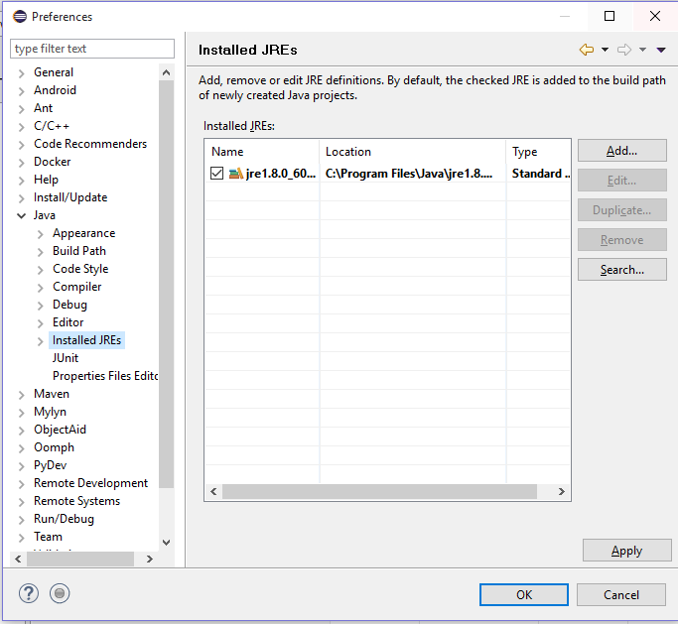
ECLIPSE IN DEVELOPMENT
Eclipse can be used to develop software modules in various languages. Languages that are supported in Eclipse include C, C++,java, ABAP, COBOL, Python, Ruby, Fortran, Birt etc.
Let us consider Java for demonstrating the Eclipse development environment.
Before getting started verify the Java runtime Environment.
Select Windows in Menu Bar > preferences >Java >Installed JRE. Confirm that a JRE has been detected.

Slide 13
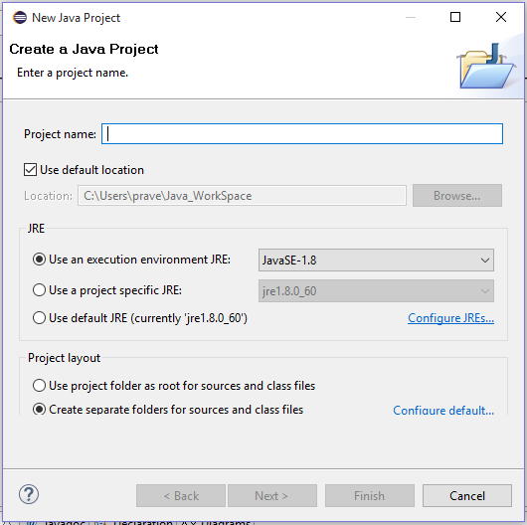
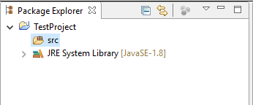
Launch Eclipse and select the menu item File > New > Project.... to open the New Project wizard
Enter the project Name and select the version of JRE to be used and click on Finish
After creating the project this can be seen in the project explored as shown in fig2.
Fig 2
In the project explorer only a source directory and an instance of JRE is created.
Fig 1

Slide 14
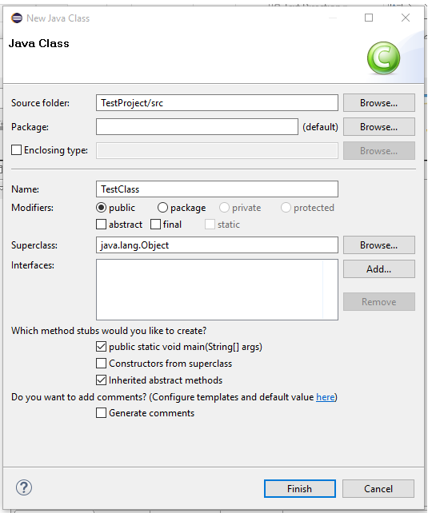
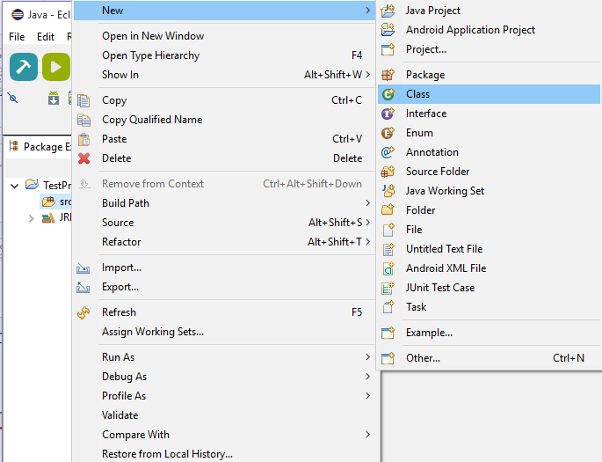
After creating the java project create a class in the source folder. Go to source package > New > Class.
A dialog box will pop up to help create the class file. Enter the class name, package name and the stubs to be created. Click Finish.(shown in fig 2).
The class file is created with empty stubs in it.
Fig 1
Fig 2

Slide 15
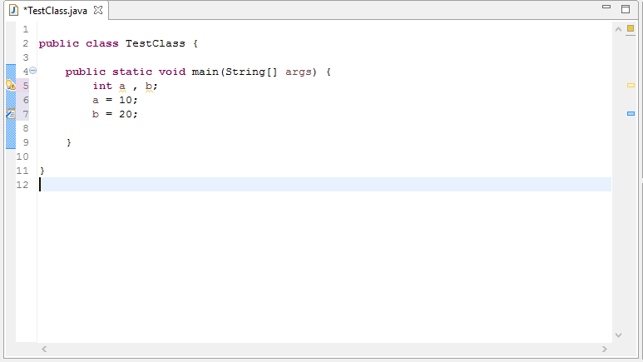
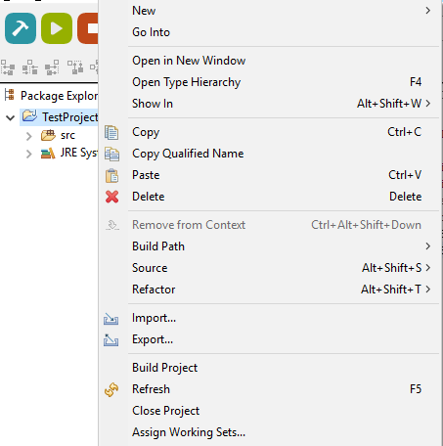
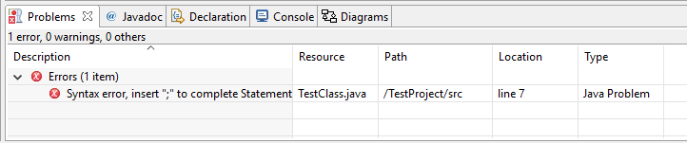
Include the source code in the file using the editor as show in fig 1. Once the source code is completed build the project by right clicking on the package and selecting build project as shown in Fig 2.
Fig 1
Build compiles all of the source files to object files, then links them together into one executable. When there is any syntax errors it is shown in the problems view of eclipse as shown below in fig 3.
Fig 2
Fig 3

Slide 16
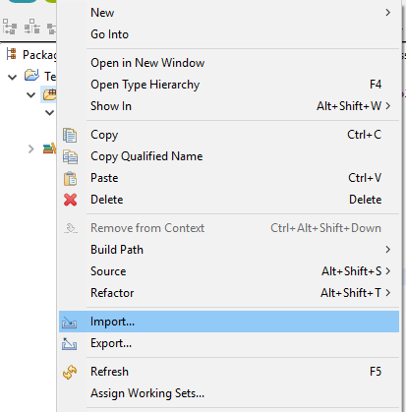
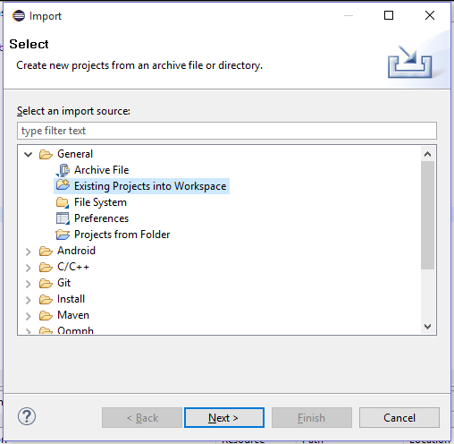
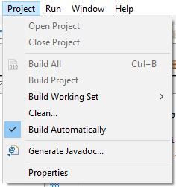
Another option in Eclipse is the build automatically option where every time the code is saved the IDE compiles source code. To check this option Click on Project option in Menu bar and select build automatically as shown in fig 1.
We can also reuse the existing code by importing the same into the workspace. For this Right Click on the package and select import. This will redirect you through a dialog box where the kind of file imported and the path of the file is specified as shown in fig 2 and fig 3.
Fig 1
Fig 2
Fig 3

Slide 17
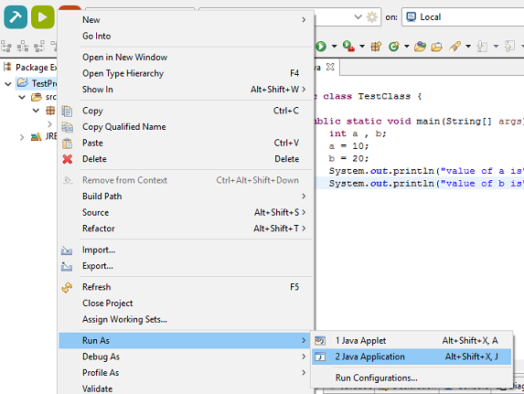
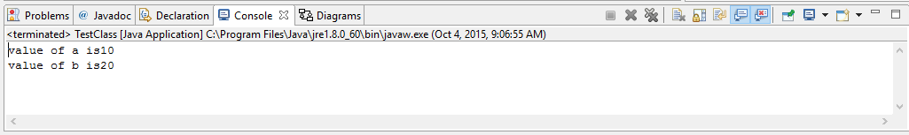
To run the project Right click on the project > Run as > Run as Java Application as shown in fig 1. The source code is executed and the results is displayed in the console view of eclipse as shown in fig 2.
Idea case if the program executes correctly the output is displayed in the console view. But when it fails, Eclipse offers a GUI based debugger which helps debugging the programs line by line.
Open Debug perspective to proceed with debugging.
Go to Perspective > open Perspective and select
debug option.
Fig 1
Fig 2

Slide 18
Java Compiler in Eclipse
Eclipse Java compiler
JCK-compliant Java compiler
Helpful error messages
Generates runnable code even in presence of errors
Fully-automatic incremental recompilation
High performance
Scales to large projects
Multiple other uses besides the obvious
Syntax and spell checking
Analyze structure inside Java source file
Name resolution
Content assist
Refactoring
Searches

Slide 19
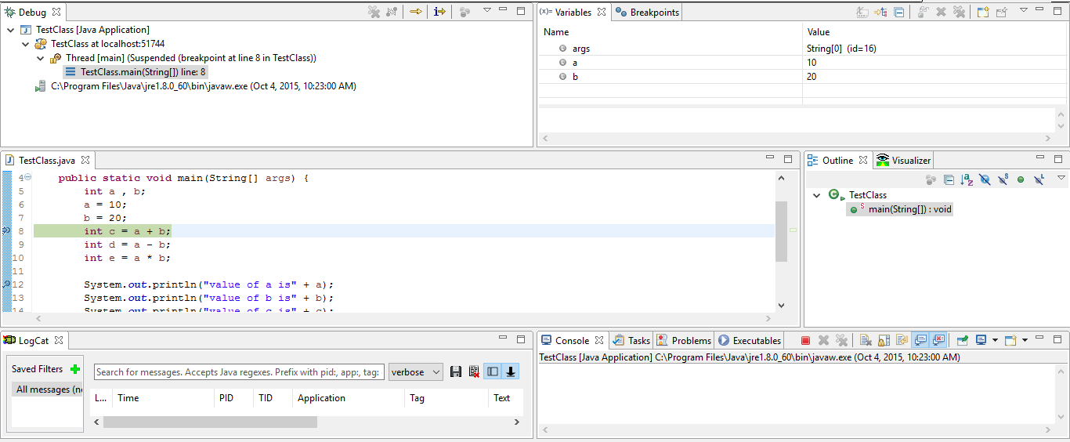
Set the break points on the lines which are to be debugged. Click on debug option a dialog box appears as a check for switching perspectives. The Debug perspective is shown below.
Local variables
Threads and stack frames
Editor with breakpoint marks
Logs
Console I/O
In this perspective we can monitor the variables and breakpoints in Variables and breakpoints tab. Instruction currently executed is highlighted in green and logs can be monitored from logcat view. Step by step instructions can be executed using F5, F6 and F7 keys or run the whole code by pressing F8.

Slide 20
Eclipse java Debugger
Run Java programs
In separate target JVM (user selectable)
Console provides stdout, stdin, stderr for input, output and errors.
Scrapbook pages for executing Java code snippets
Debug Java programs
Full source code debugging
Any JPDA-compliant JVM
Debugger features include
Method and exception breakpoints
Conditional breakpoints
Watchpoints
Step over, into, return; run to line
Inspect and modify fields and local variables
Evaluate snippets in context of method
Hot swap (if target JVM supports)

Slide 21
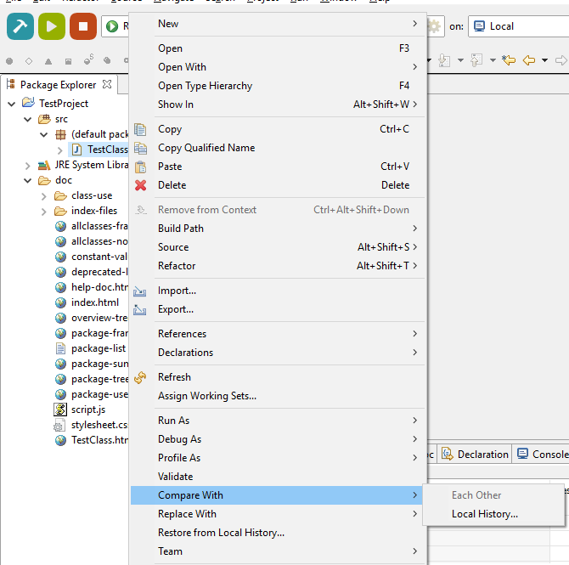
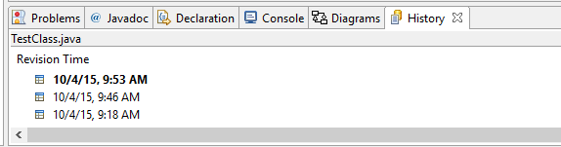
Eclipse Code Comparison
Eclipse offers a feature to compare the content of a file at different instances of time. This enables us to identify the changes made after the last stable version of the code.
To compare the code Right click on the file and select Compare with and check local history as shown in Fig 1.
This shows the files at different time stamps in the history view as shown in fig 2.
Fig 2
Fig 1

Slide 22
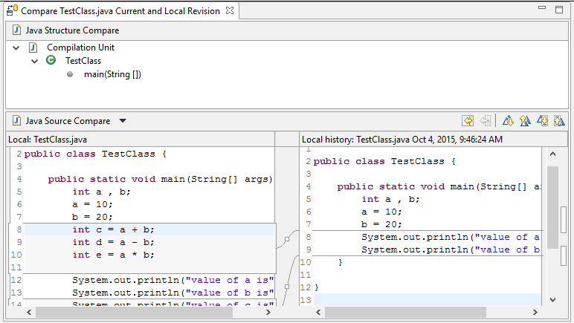
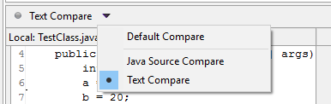
Once the appropriate entry is selected the code difference is displayed as shown in the fig below. Changes can be viewed and compared using the options provided by the editor to spot the changes (highlighted in red in fig 1).
Changes can be compared either using the java source compare or general text compare. This can be chosen with the options available. (fig2)
Fig 2
Fig 2

Slide 23
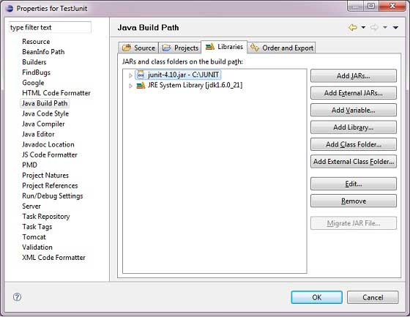
ECLIPSE IN TESTING
A software test is a piece of software which executes another pierce of software and validates if that code results in the correct state (state testing) or executes the correct sequence of events (behavior testing).
Software unit tests allow the developer to verify that a piece of program logic is correct.
There are several kinds of testing that has been integrated on Eclipse. For demonstration let us consider Junit testing here.
A JUnit test is a method contained in a class which is only used for testing. This is called a Test class.
To start with junit development in eclipse download Junit archive and save it in a directory.
Open eclipse -> right click on project and click on property > Build Path > Configure Build Path and add the junit-4.10.jar in the using Add External Jar button.
Junit plugin is required to which is a part of JDT. To install
JDT check here

Slide 24
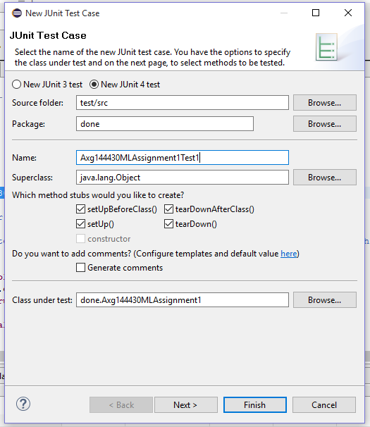
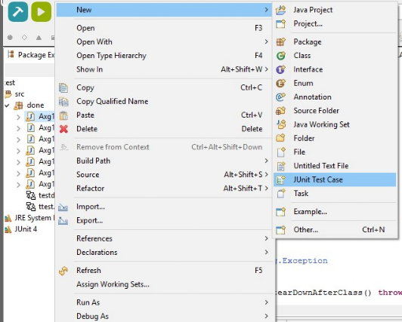
To use JUnit you must create a separate .java file in your project that will test one of your existing classes. In the Package Explorer area on the left side of the Eclipse window, right-click the class you want to test and click New → JUnit Test Case.(shown in fig 1)
A dialog box will pop up to help you create your test case.
Make sure that the option at the top is set to use JUnit 4, not
JUnit 3. Click Next.(shown in fig 2)
Fig 1
Fig 2

Slide 25
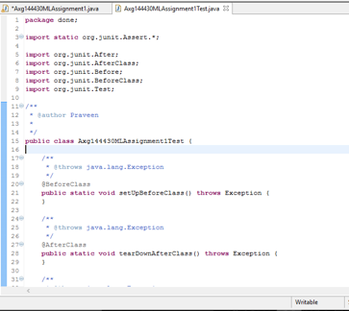
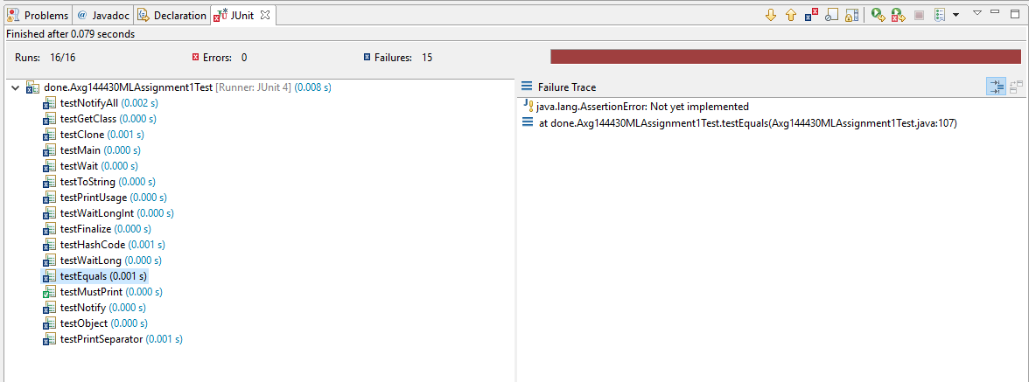
This creates a test file with built in skeleton of the test cases of the methods in the class and the setup and the teardown methods.(shown in fig 1)
Write the test cases for individual modules or methods and run the test cases. To run the test cases right click on project -> run as ->junit test.
Once the test case is executed it shows the results as shown in fig(2) in the Junit view of Eclipse.
Fig 2
The results are of 3 kinds
Errors : Test Cases with errors
Failures : Test cases with wrong logic
Success : Test cases that passed the test.
Fig 1

Slide 26
ECLIPSE IN DESIGN
Eclipse can be used for developing the design documentation of a project like Class diagram, Sequence diagram etc.
Eclipse has a plugin called Object Aid which generated the class diagram and sequence diagram from the source code.
ObjectAid can be installed from here with the installation instructions here.
The ObjectAid UML Explorer is an agile and lightweight code visualization tool for the Eclipse IDE.
It shows your Java source code and libraries in live UML class and sequence diagrams that automatically update as your code changes.
It uses the UML notation to show a graphical representation of existing code that is as accurate and up-to-date as the text editor, while being very easy to use.
Using ObjectAid all diagrams in your Eclipse workspace are updated with refactoring changes as appropriate. If necessary, they are checked out of your version control system.

Slide 27
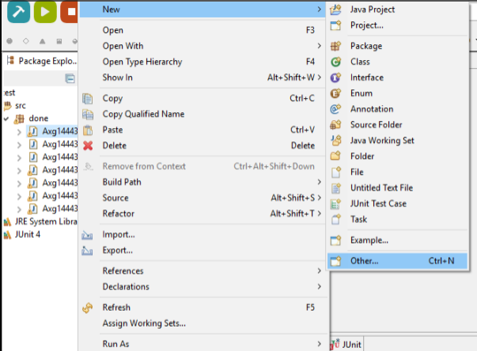
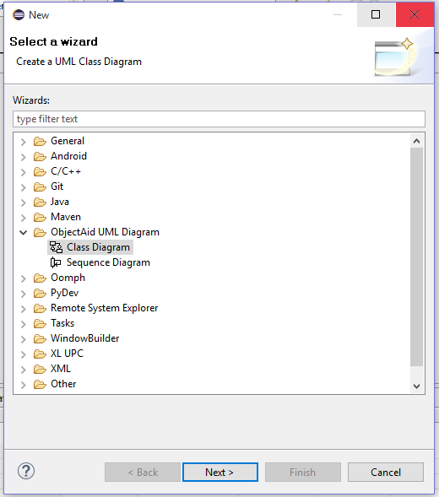
ObjectAid : A Plugin for Eclipse
Objectaid is a free tool for Eclipse which can be used to automatically create class diagrams.
Lets consider the procedure for creating UML Class diagrams.
After installing the plugin, from the package explorer or File menu , create a new ObjectAid class diagram
Click on the File package -> New -> Other and select Class Diagram.

Slide 28
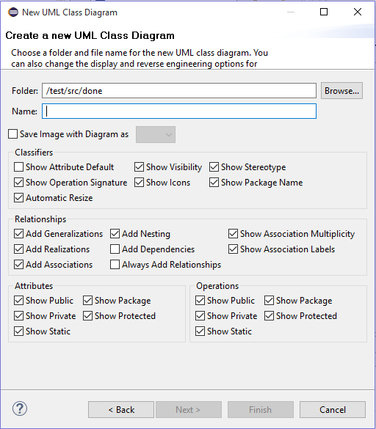
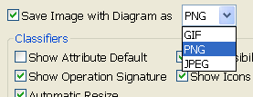
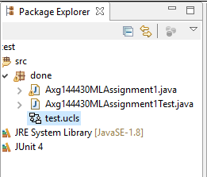
While creating the diagram , you can specify what all Classifiers and Relationships among classes you need in the diagram to have . You can also specify the Attributes and Operations of a class that you want to be shown in the diagram.
You can mark Save Image in case you need the diagram in an Image file for some presentation etc.
Once created , the Class diagram icon will show in package explorer.

Slide 29
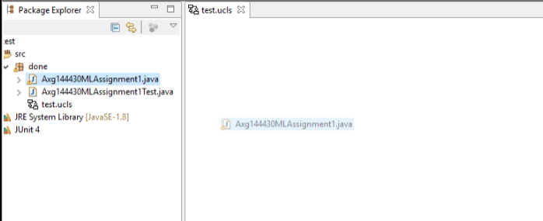
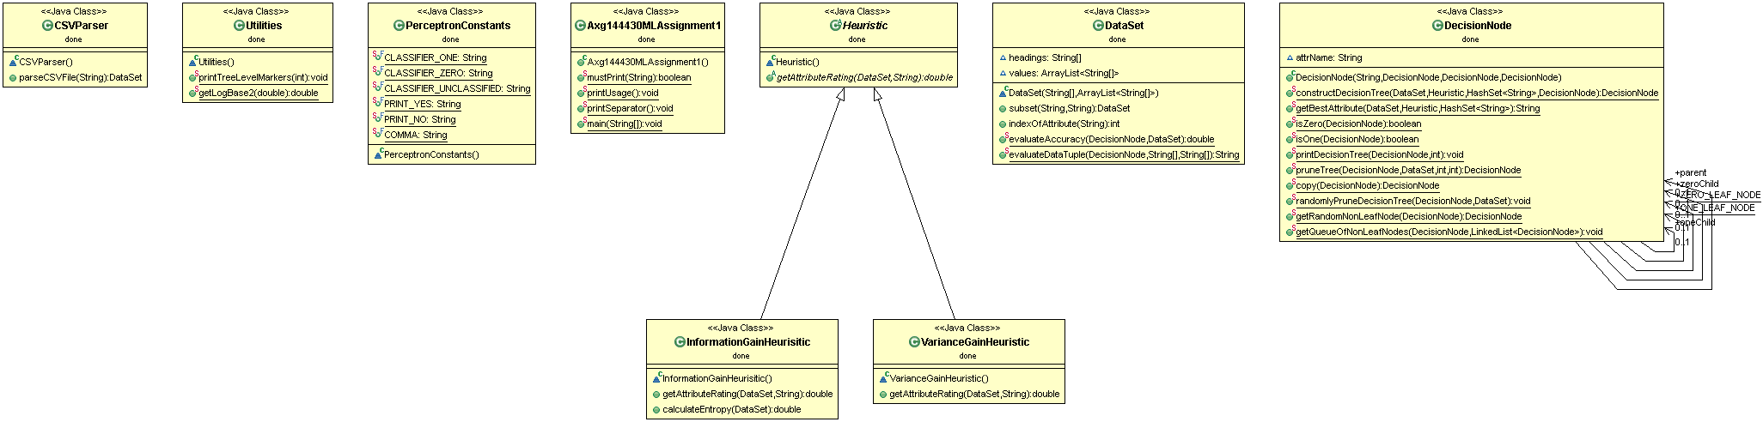
You can open and drag into it the classes whose diagram you want to create.
After you drag , the diagram will appear , listing the attributes and operations were allowed while creating it. Example shown in figure below.

Slide 30
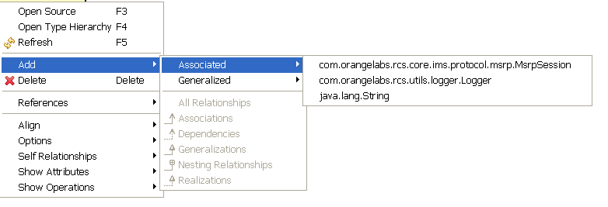
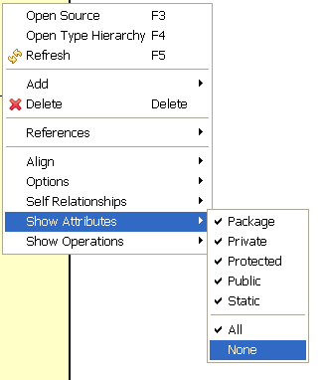
Right click on a class to open the menu which has useful operations through which you can extend the diagram by adding Associates and Relationships. By clicking an operation or attribute , you can go to its source code .
If you want to change the type of attributes and operations you allowed while creating the diagram , you can also change it from this Menu.(shown in fig 2)
Fig 2

Slide 31
ObjectAid Advantages
Several unique features of ObjectAid includes:
Generates the diagram with simple drag and drop.
Any update in the code in Eclipse, UML diagram is updated as well; there is no need to reverse engineering of the source code.
Refactoring updates on the diagram as well as the source code. Renaming a field or moving a class, diagram simply reflects the changes without going out of sync.
All diagrams in Eclipse workspace are updated with refactoring changes as appropriate. If necessary, they are checked out of version control system.(Integration of Version control)
Diagrams are fully integrated into the Eclipse IDE. Java classes can be dragged from any other view onto the diagram, and diagram-related information is shown in other views wherever applicable.
The ObjectAid UML Explorer achieves all this while staying light, fast and easy to use
More options are available to edit the diagram by adding and removing certain features and relationships in the diagram.
For more information check this.

Slide 32
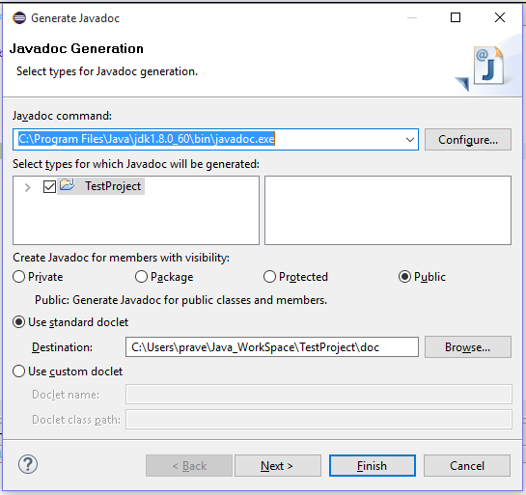
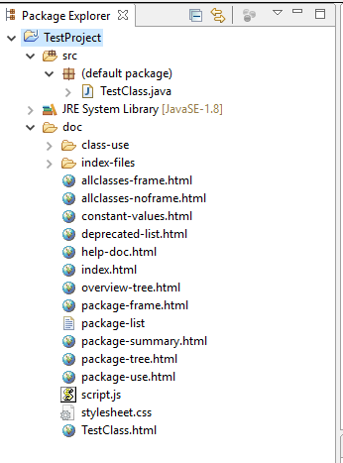
JAVADOC IN ECLIPSE
Javadoc is a documentation generator created by Sun Microsystems for the Java language for generating API documentation in HTML format from Java source code.
We can generate the javadoc for a java project from Eclipse. Go to project > generate java doc.
At first step, define settings for:
Select path for the javadoc.exe tool from the JDK
Classes and methods for which to generate Javadoc based on their visibility.
Location of the Javadoc as shown in fig 1.
Generated Javadoc can be viewed in the project explorer(fig 2).
Fig 2
Fig 1

Slide 33
ECLIPSE IN SOURCE CONTROL
Source Control or Version Control is the management of source code of softwares and other files.
These can be used to track the changes and revert back if necessary without affecting the other modules. Each changes made are identified by a unique Identifier.
Examples include : Perforce, Git, ClearCase, Vault etc.
ECLIPSE has been integrated with a plugin called Egit to access Git repositories.
For instructions to install the Egit plugin into Eclipse click here.
Git is a distributed SCM(), which means every developer has a full copy of all history of every revision of the code, making queries against the history very fast and versatile.
This is one of the major features of Eclipse because of which it is used in industrial developments as well. It can be integrated with many public and private Source Control tools.
Examples : Perforce – P4Eclipse, Git – Egit etc.

Slide 34
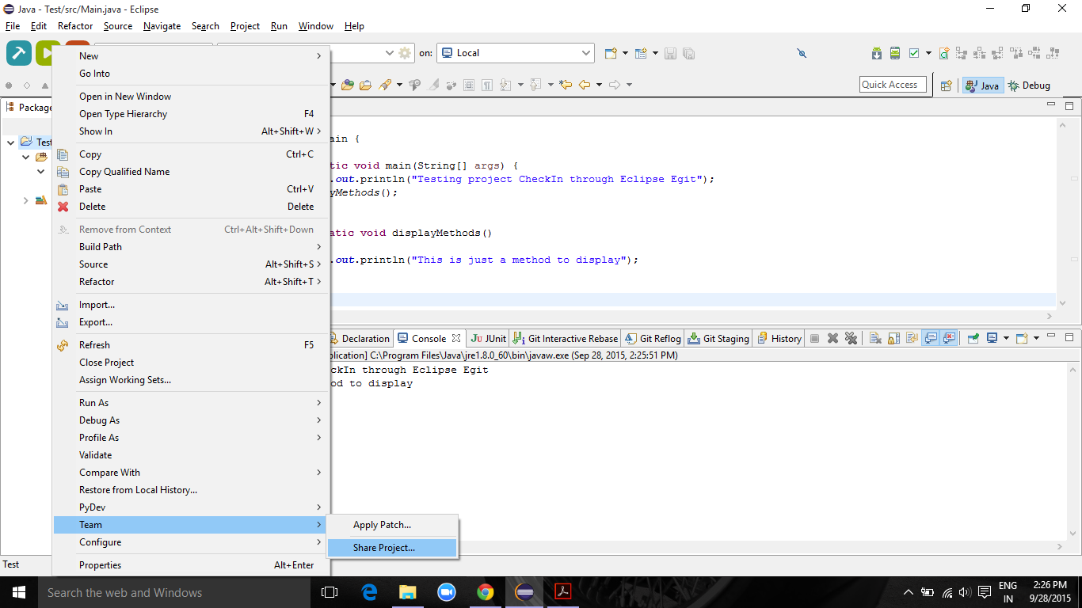
EGIT - Plugin for Git in Eclipse
Lets consider an example of Egit for the Source Control in Eclipse.
Install Egit plugin on Eclipse from here.
Create a sample project in any language and save it.
For Ex : a project named Test is
created here.
Right Click on the project and
select Team -> Share Project.
Share the project on Git and
this allows you to create a
local repository for the project
if it is not created previously.

Slide 35
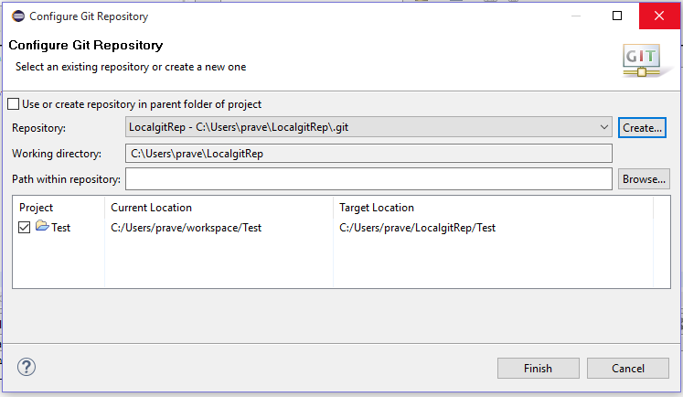
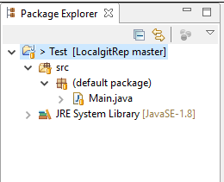
To create a repository click on the Create button in the pop-up and specify a name. A local repository is created with the name specified and initializes Git in the repository. This is equivalent to executing “git init” command in the repository.
Once the repository is created and initialized the structure in the project explorer displays the repository name and the branch name in git if any. In the example fig 2 the project is in LocalgitRep directory and on master branch.
Fig 2

Slide 36
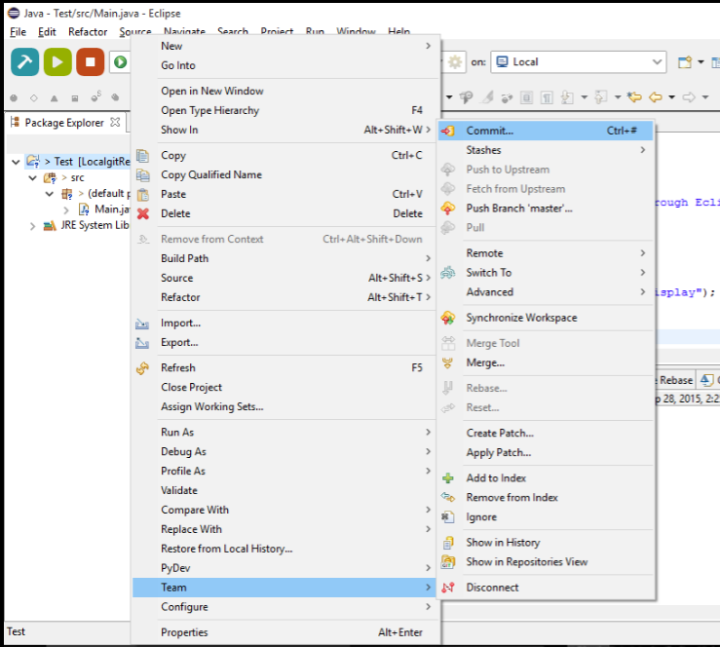
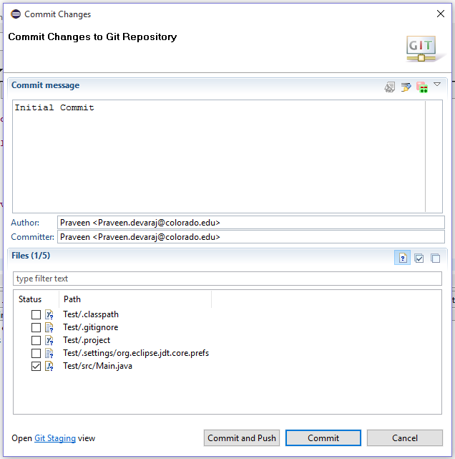
To add the changes made into the local repository we use the commit option. This pushes all the data in the staging area into the local workspace.
To commit right click on the project and select team and check commit option as shown in fig 1.
Fig 1
Fig 2
After checking the commit option a pop up is displayed where we fill the commit message and select the files individually which are to be committed. (shown in fig 2)

Slide 37
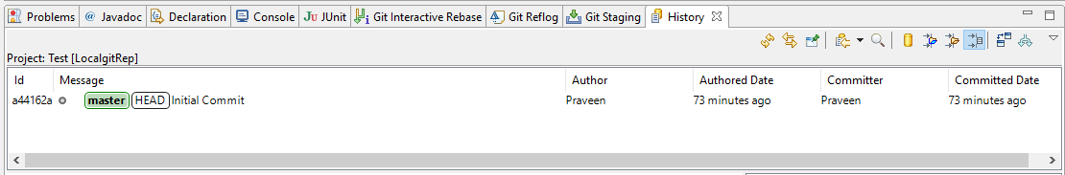
After the changes are committed we can check the branch and the commit changes in the history view of eclipse. To view this right click on the project and select show In history.
History View shows the author , branch information, commit messages and their Ids, Authored Date and the date of each commit. Ex : Figure 1, this has only one commit on Master branch.
All the changes committed are now saved in the local repository and not in the server.
To push the changes from the local repository to the remote repository we use the push option available when we right click on project and select Team.
A pop up appears when clicked on Push which requests for the url of the repository and the user credentials to authenticate the user. (show in Next Slide)
Successful push sends the changes to the remote repository and can be viewed on github account of the user.

Slide 38
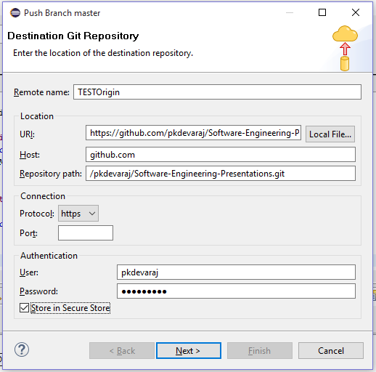

Fig 1 (left) : Pop up window for push command.
Fig 2 (below) : View of file in Github remote repository
Eclipse offers a GUI based access to Git and is integrated to the development environment which makes it easier to use.
Similarly Eclipse offers a wide range of plugins for many Source Control SCMs.
More information on Egit can be found here.

Slide 39
ECLIPSE AND ANT BUILD
ANT build is a software tool for automating build processes developed in java.
The main known usage of Ant is the build of Java applications. Ant supplies a number of built-in tasks allowing to compile, assemble, test and run Java applications.
Ant can also be used effectively to build non Java applications, for instance C or C++ applications. More generally, Ant can be used to pilot any type of process which can be described in terms of targets and tasks.
The most immediately noticeable difference between Ant and Make is that Ant uses XML to describe the build process and its dependencies, whereas Make uses Makefile format.
Ant buildfiles are just text files, to create an Ant buildfile in Eclipse: File > New > File (Enter a name for the file) Click Finish.
By default the Ant Editor has an association with build.xml file or File associations can be manually set using Window > Preference > General > Editors > File associations and add an association between the created xml file and the ant editor.
Now, as long as the file has a .xml extension, Eclipse will consider it to be a possible Ant buildfile, and will enable Ant-related actions when it is selected. Until a file has Ant buildfile content, you will need to open it using Open With > Ant Editor.

Slide 40


Open the xml file created with the Ant Editor and add the contents as shown in Fig 1.
Notice the syntax coloring for property values.
Save the buildfile contents.
Select the file and run as AntBuild from its context menu. A dialog appears as shown in Fig 2.
This dialog allows the configuration of many aspects of the way an Ant buildfile is run, but for now concentrate on the Targets tab which allows the selection of which Ant targets to run and their order. Select both targets and leave the order as the default. Click on Run and the output is displayed in the console view.
Fig 1: Contents in the xml file
Fig 2: Dialog box to run the ant build file

Slide 41

Memory Analyzer in Eclipse
The Eclipse Memory Analyzer is a fast and feature-rich Java heap analyzer that helps you find memory leaks and reduce memory consumption.
Use the Memory Analyzer to analyze productive heap dumps with hundreds of millions of objects, quickly calculate the retained sizes of objects, see who is preventing the Garbage Collector from collecting objects, run a report to automatically extract leak suspects.
Eclipse represents the memory utilized at that point in time by a process in a graphical representation as shown in Fig.
For more information check this.

Slide 42
LTTng Plug-in for Eclipse
LTTng - Linux Trace Toolkit, next generation.
This is a highly efficient tracing tool for Linux that can be used to track down kernel and application performance issues as well as troubleshoot problems involving multiple concurrent processes and threads.
It consists of a set of kernel modules, daemons - to collect the raw tracing data - and a set of tools to control, visualize and analyze the generated data. It also provides support for user space application instrumentation.
The LTTng Eclipse plug-in has a number of features to allow efficient handling of very large traces
Support for arbitrarily large traces (larger than available memory)
Support for correlating multiple time-ordered traces
Support for zooming down to the nanosecond on any part of a trace or set of traces
Views synchronization of currently selected event
Efficient searching and filtering of events
Support for trace bookmarks
For more information about LTTng, refer to the project site.

Slide 43
Callgraph plug-in for Eclipse
A graphical explorer for call and class hierarchies. Designed to help understand complex relations in larger scale applications.
This plug-in allows you to profile C/C++ projects directly within the Eclipse IDE, providing various runtime details such as:
The relationship between function calls
Number of times each function was called
Time taken by each instance of a function (relative to the program's execution time)
Time taken by all instances of a function (relative to program's execution time)
Eclipse Callgraph uses SystemTap to perform function traces. For more information about SystemTap, refer to the here.
This leverages the internal platform Call Hierarchy and Search mechanisms.
For more information check this.

Slide 44
References:
http://www.eclipse.org
http://help.eclipse.org/mars/index.jsp
http://www.csee.umbc.edu/courses/undergraduate/341/fall08/Lectures/Eclipse
http://homepage.cs.uiowa.edu/~sriram/21/fall08
http://objectaid.com
http://www.eclipse.org/egit
http://ant.apache.org
https://marketplace.eclipse.org/content/callgraph-viewer#sthash.CVhMjnkx.dpuf

